Slide 1
Testing repeatability of global distances in UMAPs

Slide 2
Datasets
MNIST
Alam dataverse

Slide 3
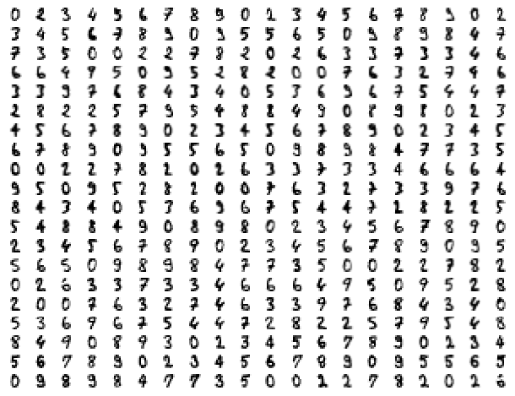
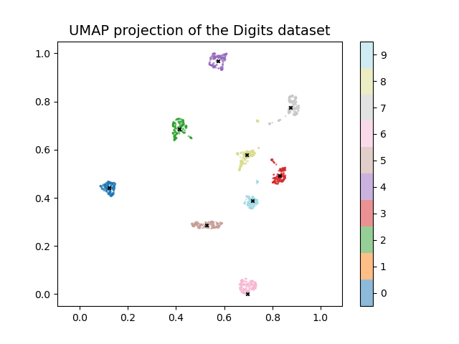
MNIST – Test #1
10 seeds

Slide 4
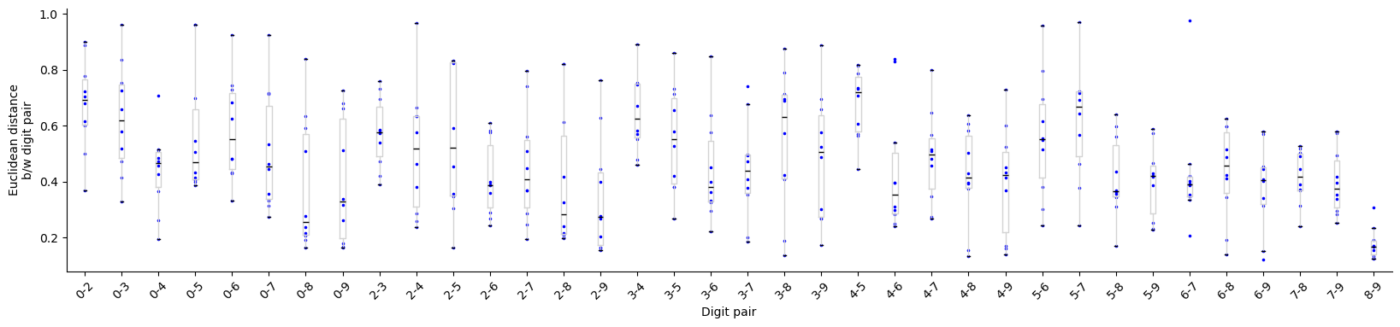
MNIST – Test #1

Slide 5
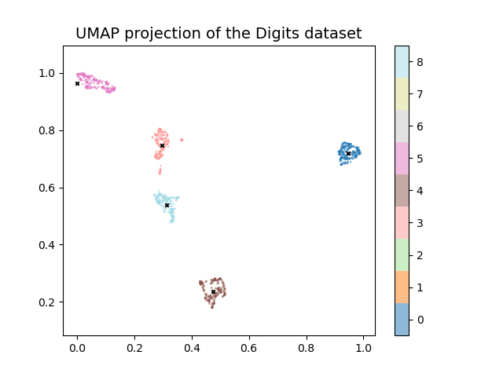
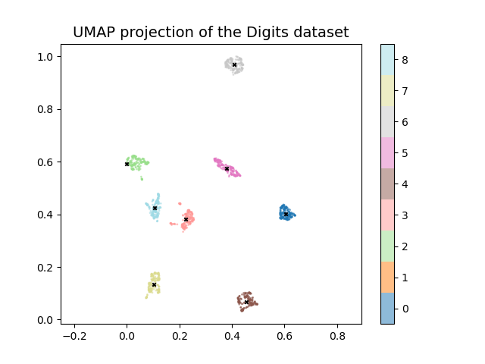
MNIST – Test #2
All combinations

Slide 6
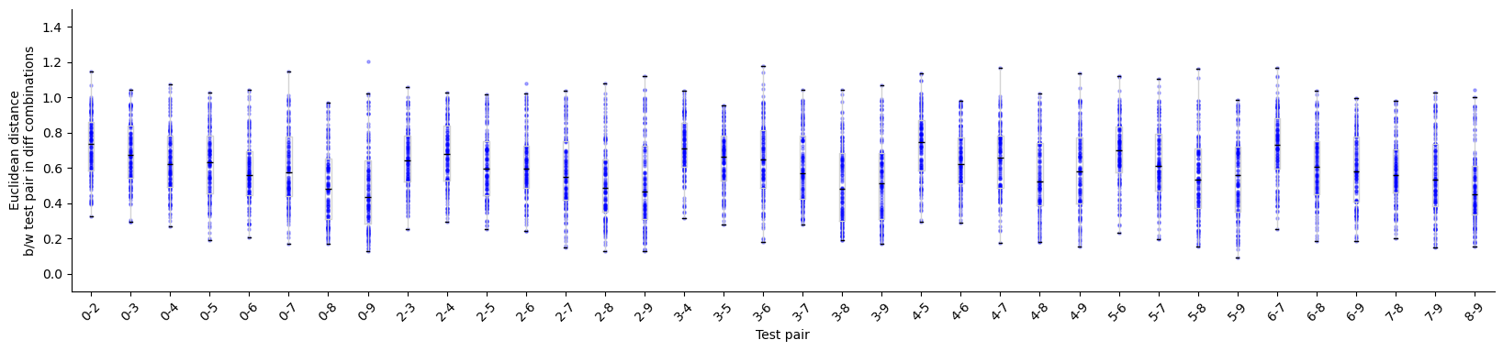
MNIST – Test #2a

Slide 7
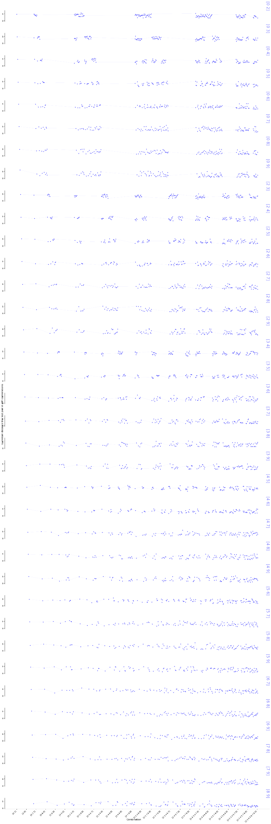
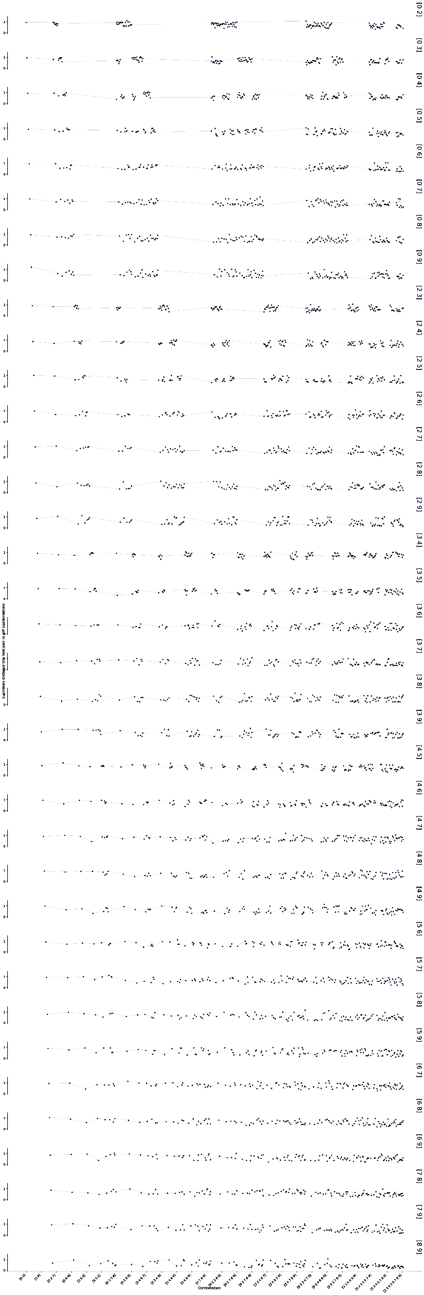
MNIST – Test #2b

Slide 8
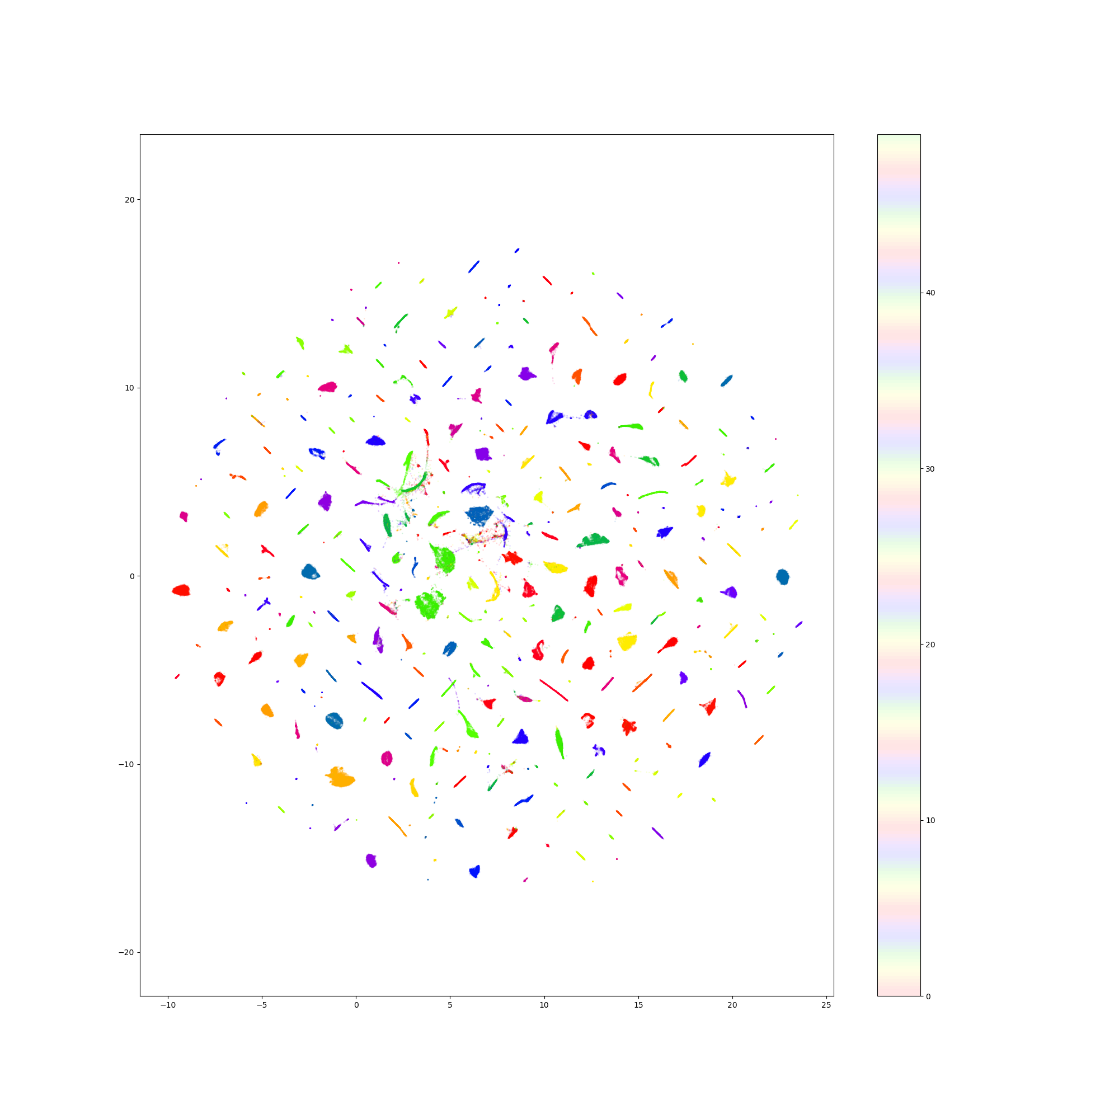

Alam

Slide 9
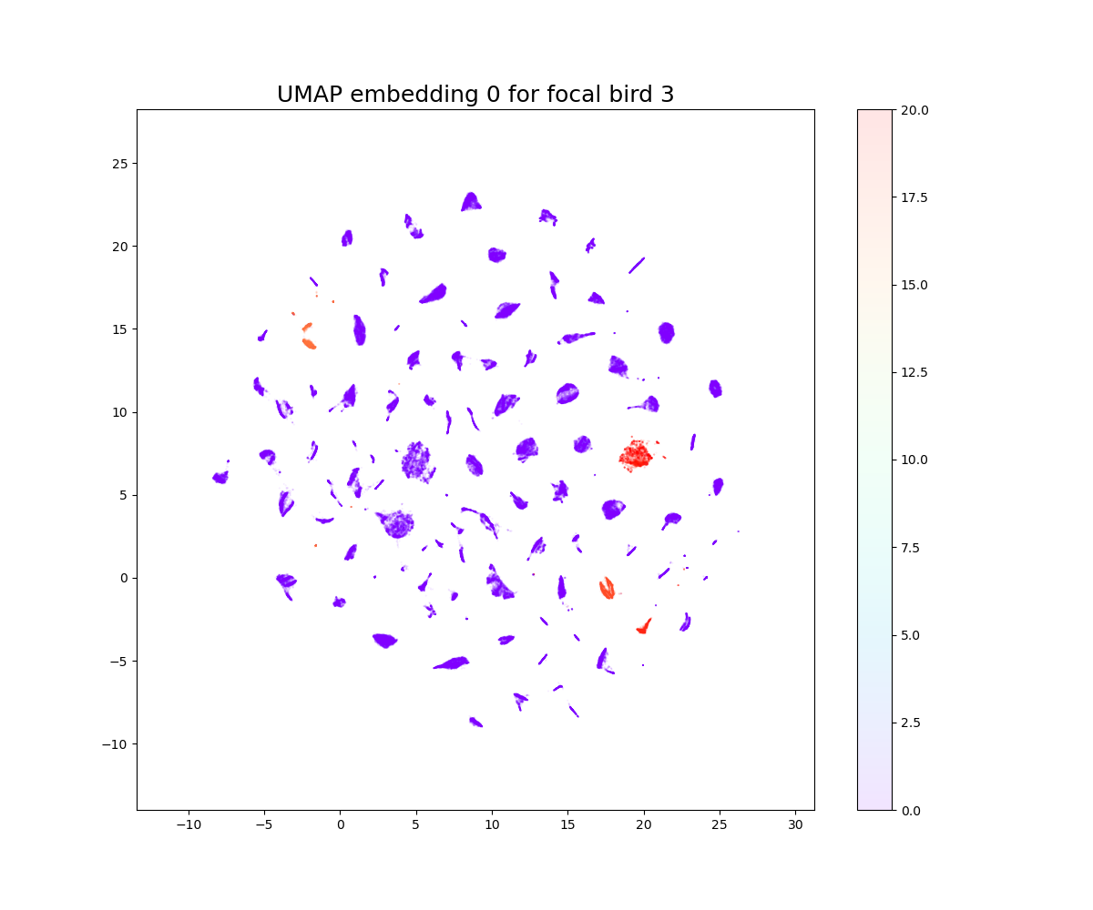
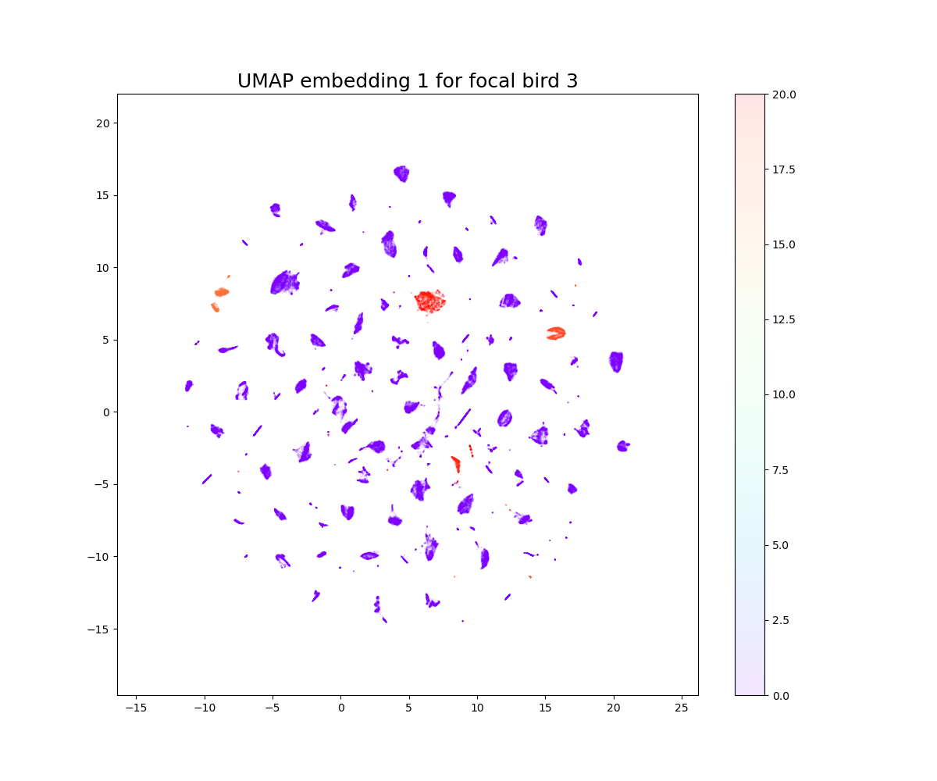
Alam – Test #1: Split

Slide 10
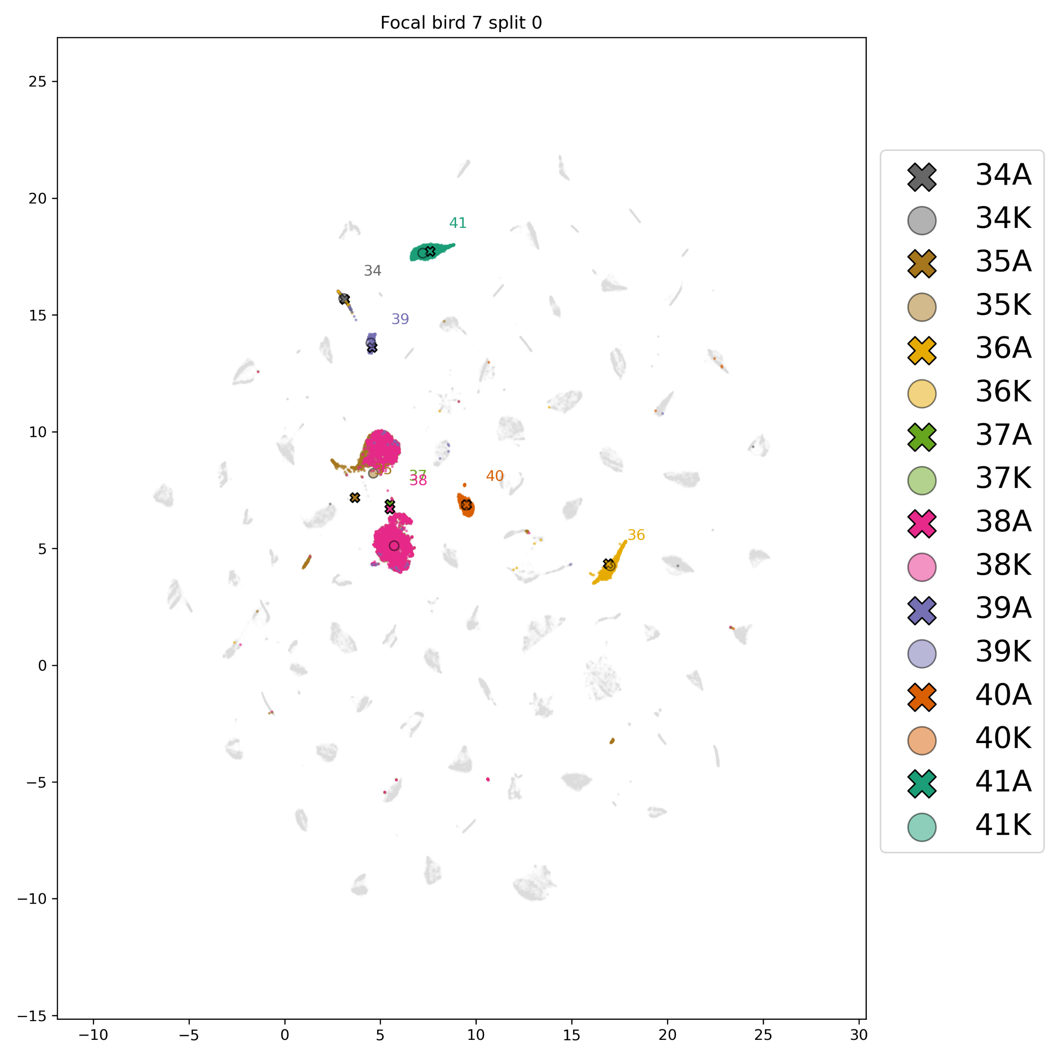
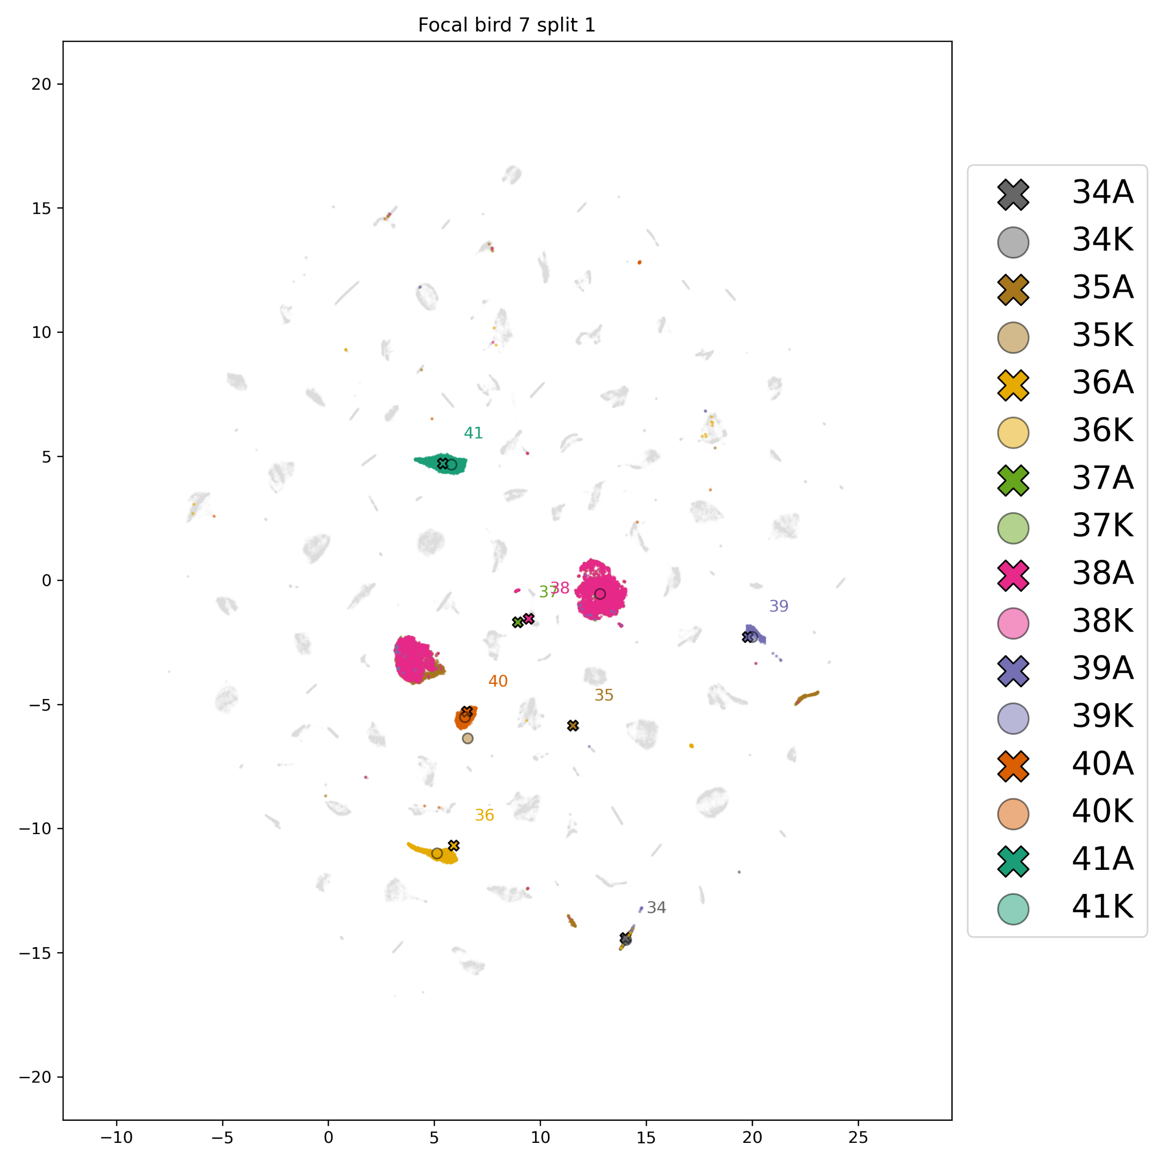
Alam – Test #1: Split

Slide 11
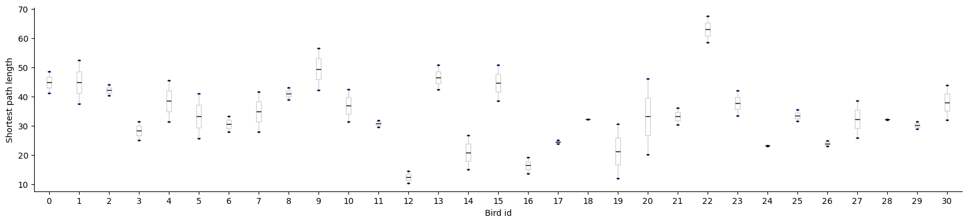
Alam – Test #1: Split

Slide 12
Alam – Test #1: Split

Slide 13
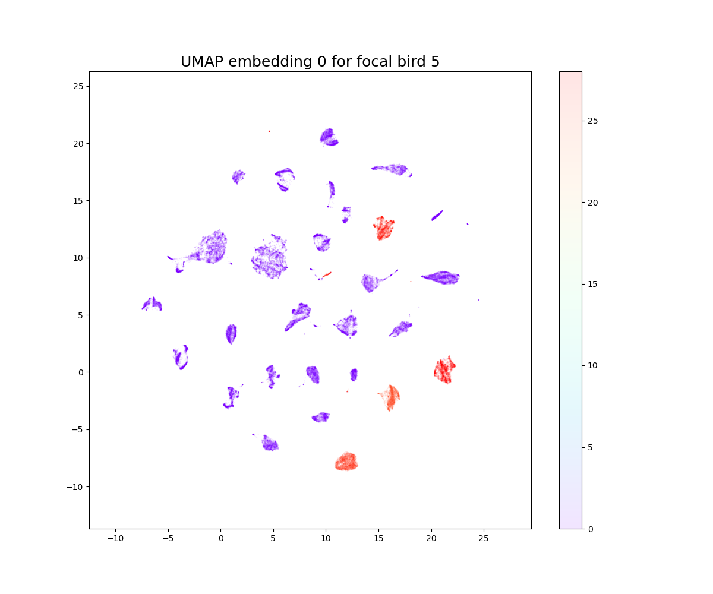
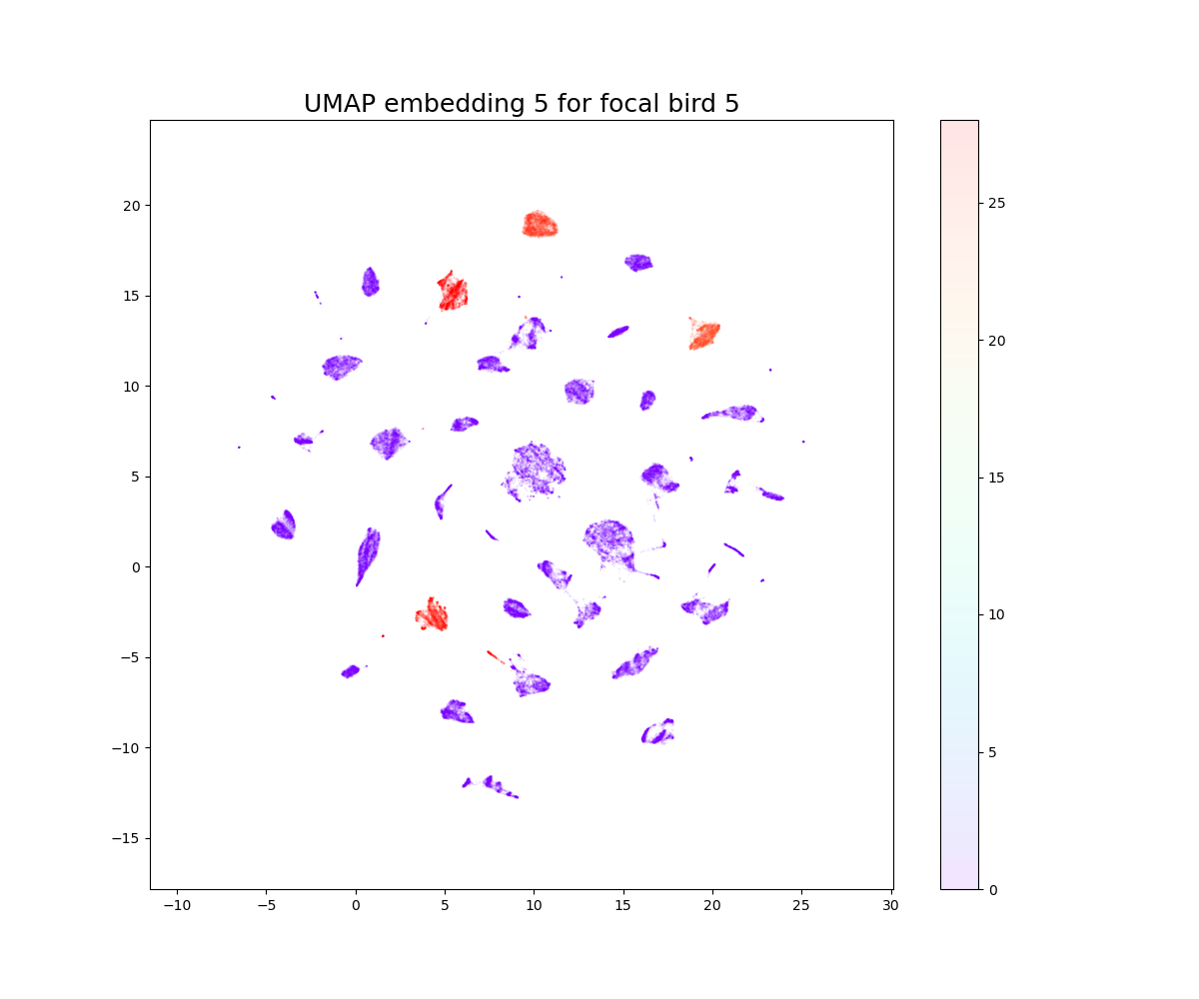
Alam – Test #2: Combinations

Slide 14
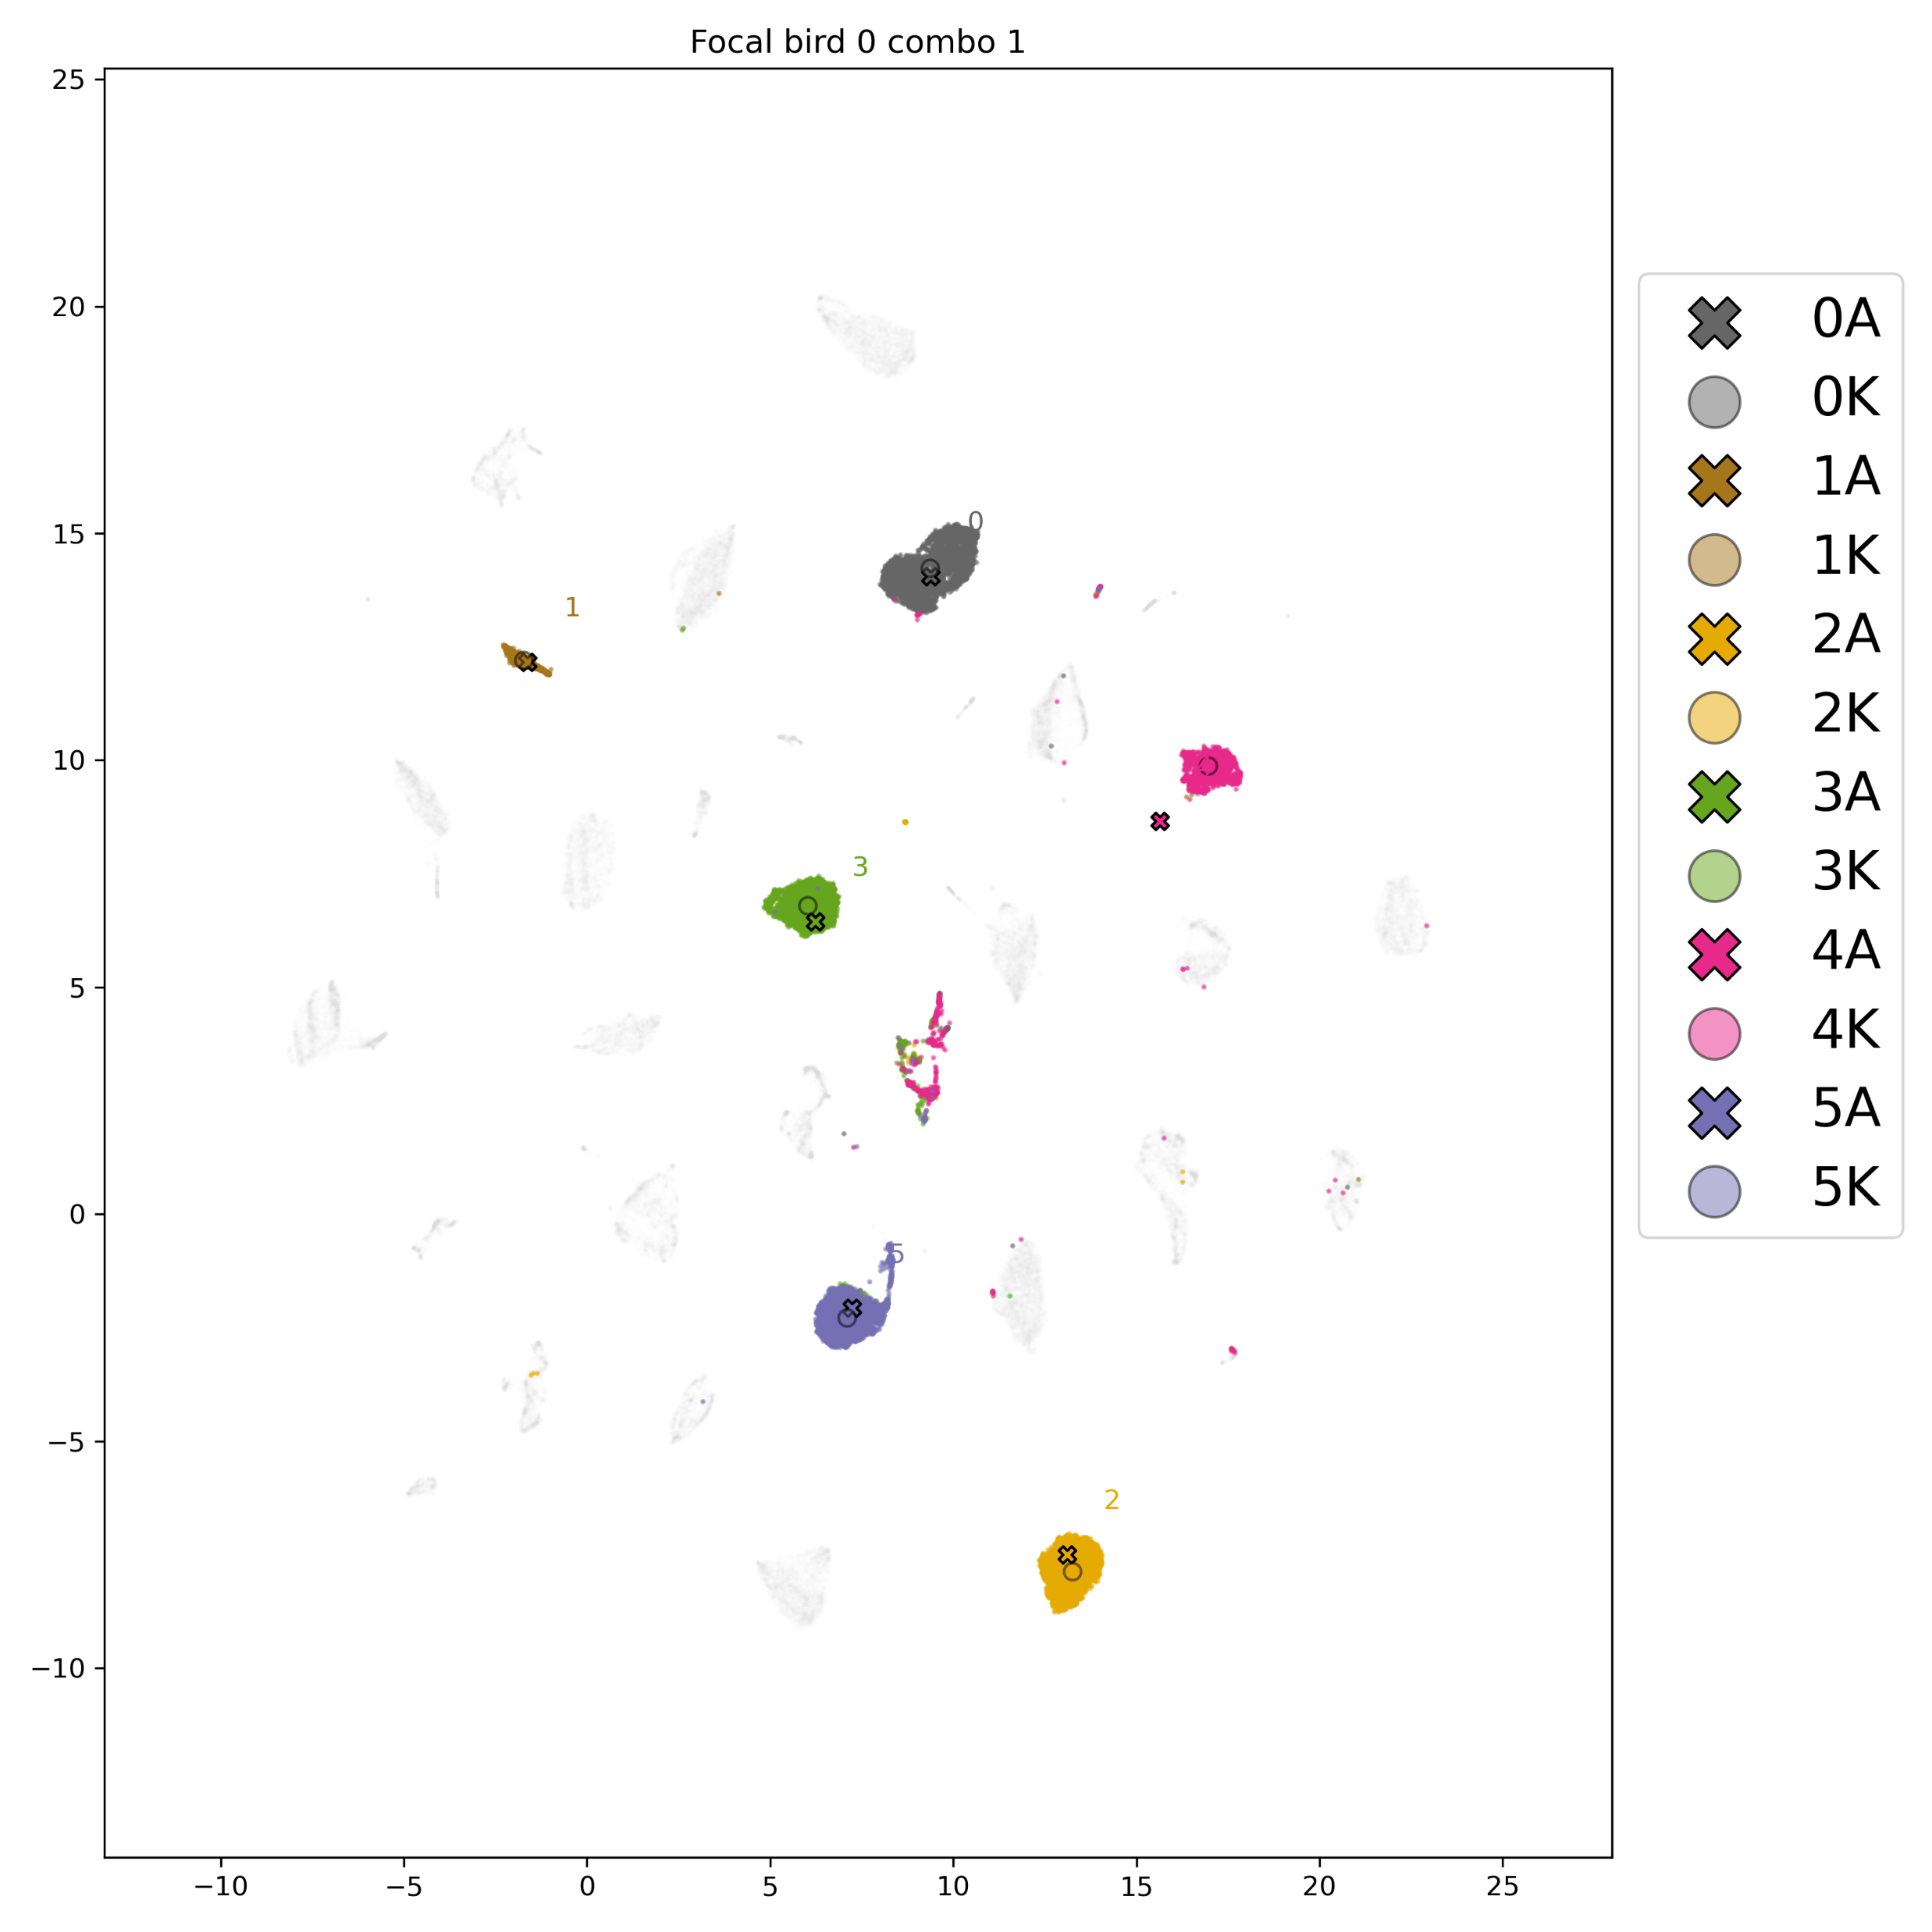
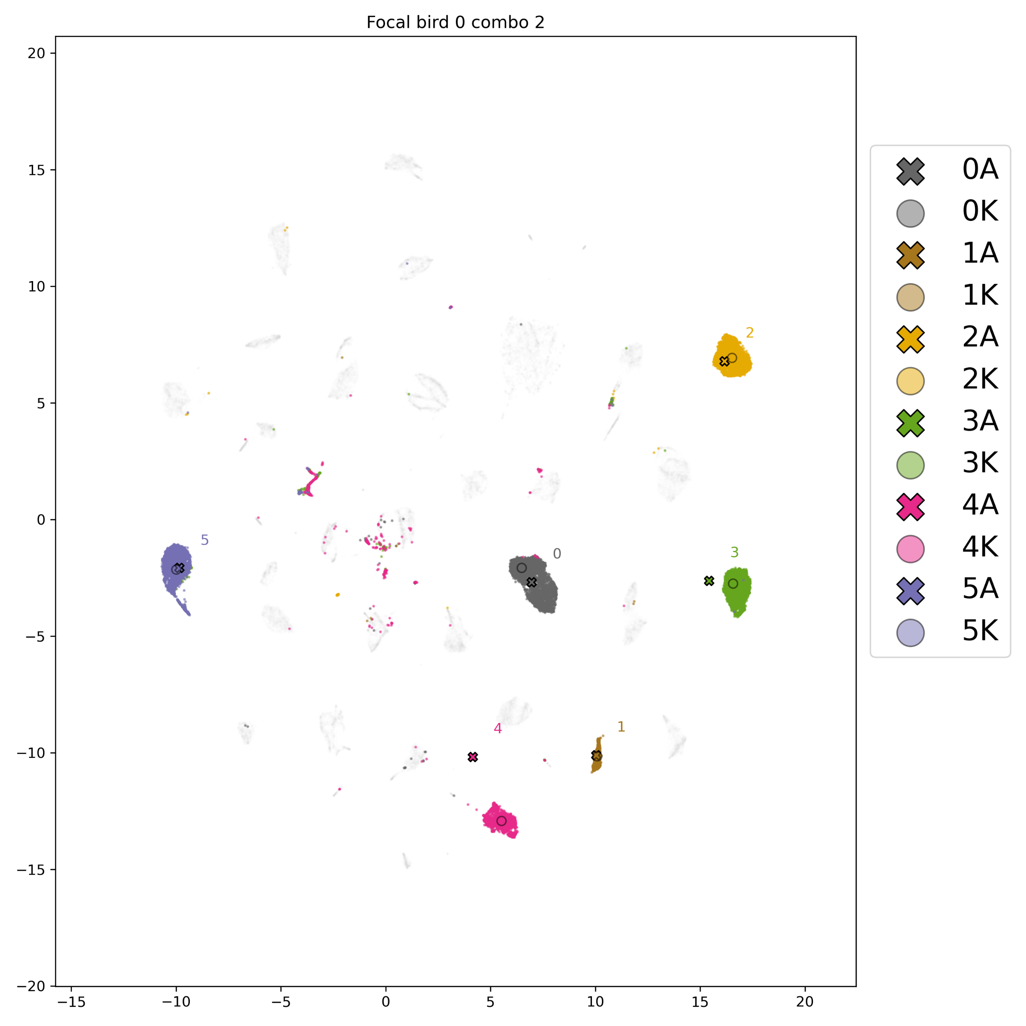
Alam – Test #2: Combinations

Slide 15
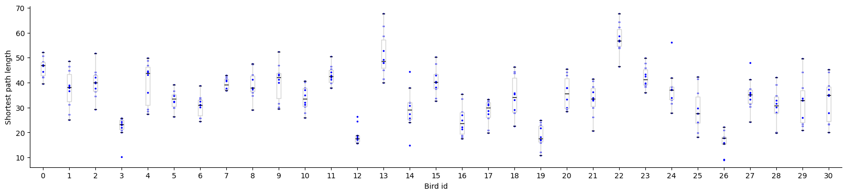
Alam – Test #2: Combinations

Slide 16
Alam – Test #2: Combinations

Slide 17
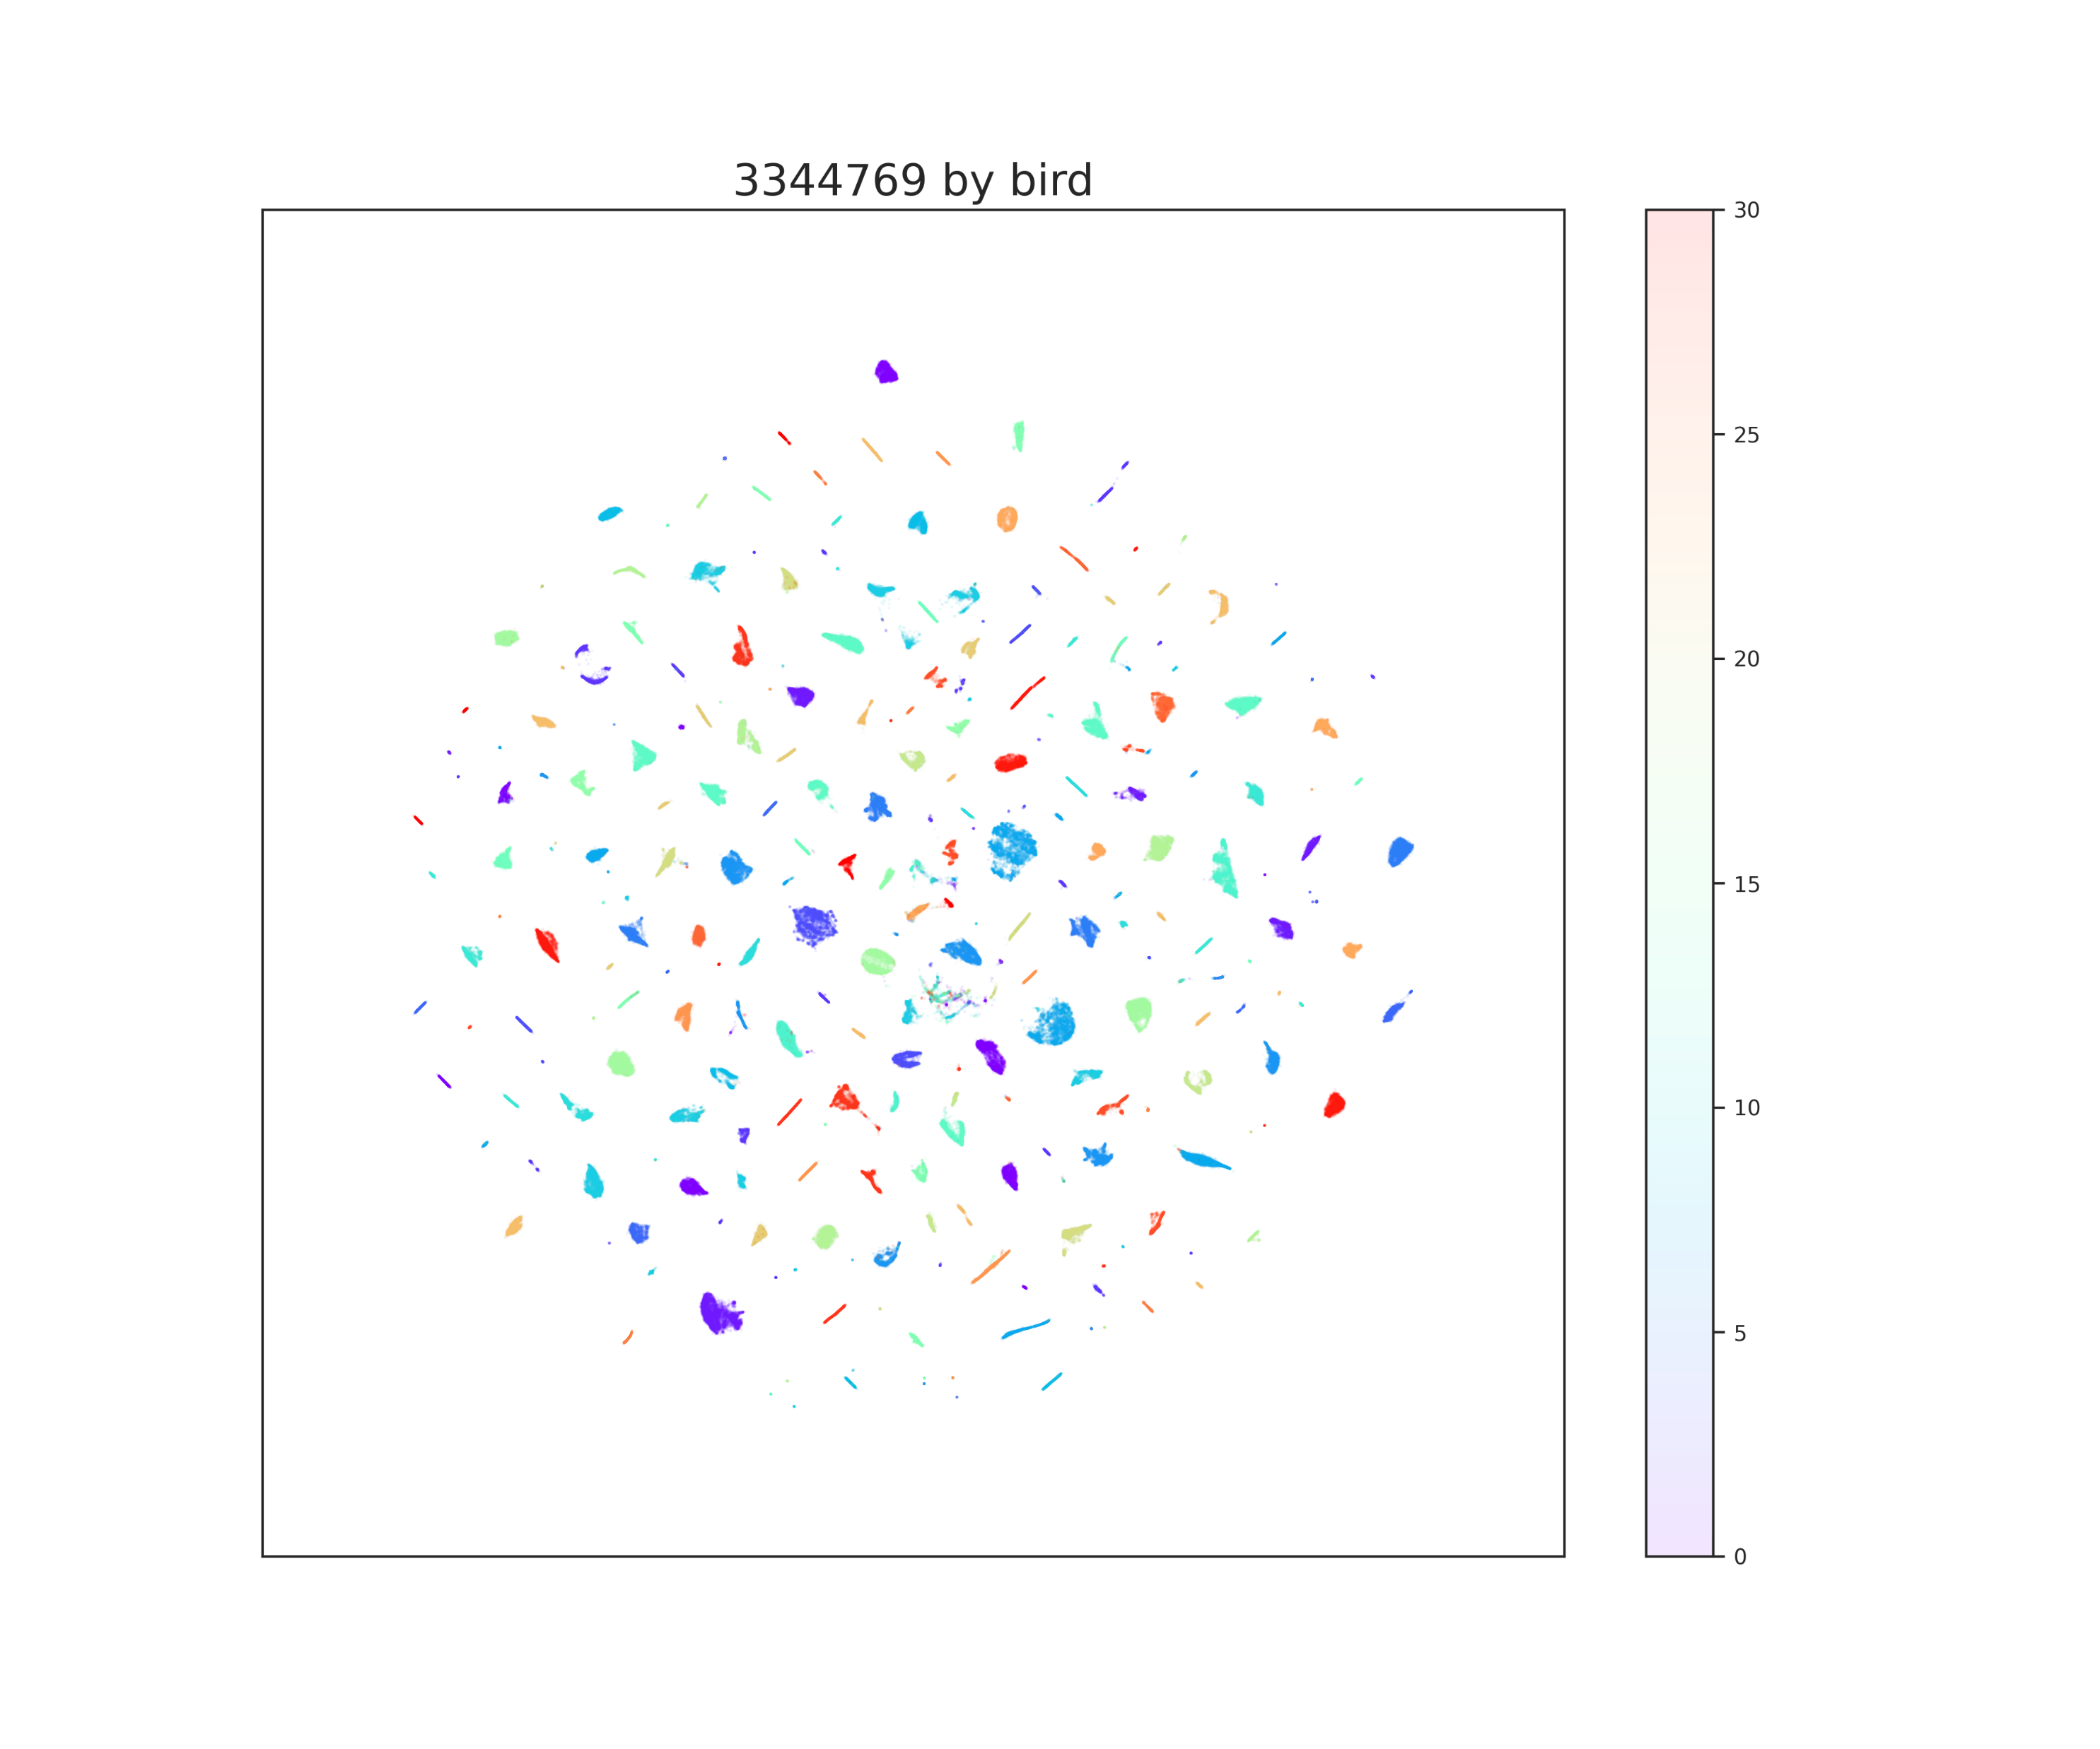
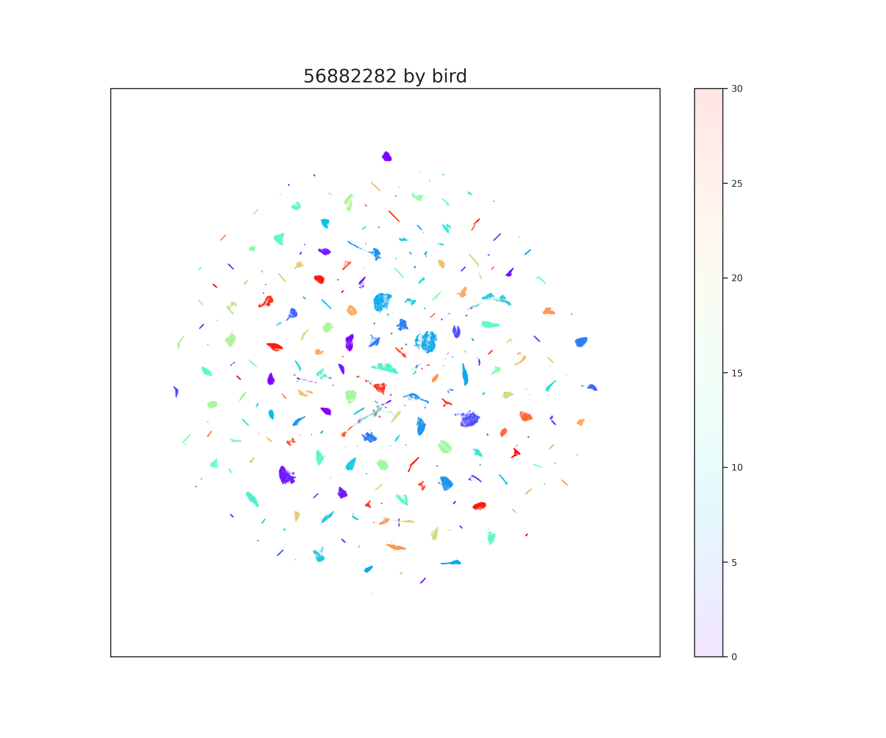
Alam – Test #3: Rseed

Slide 18
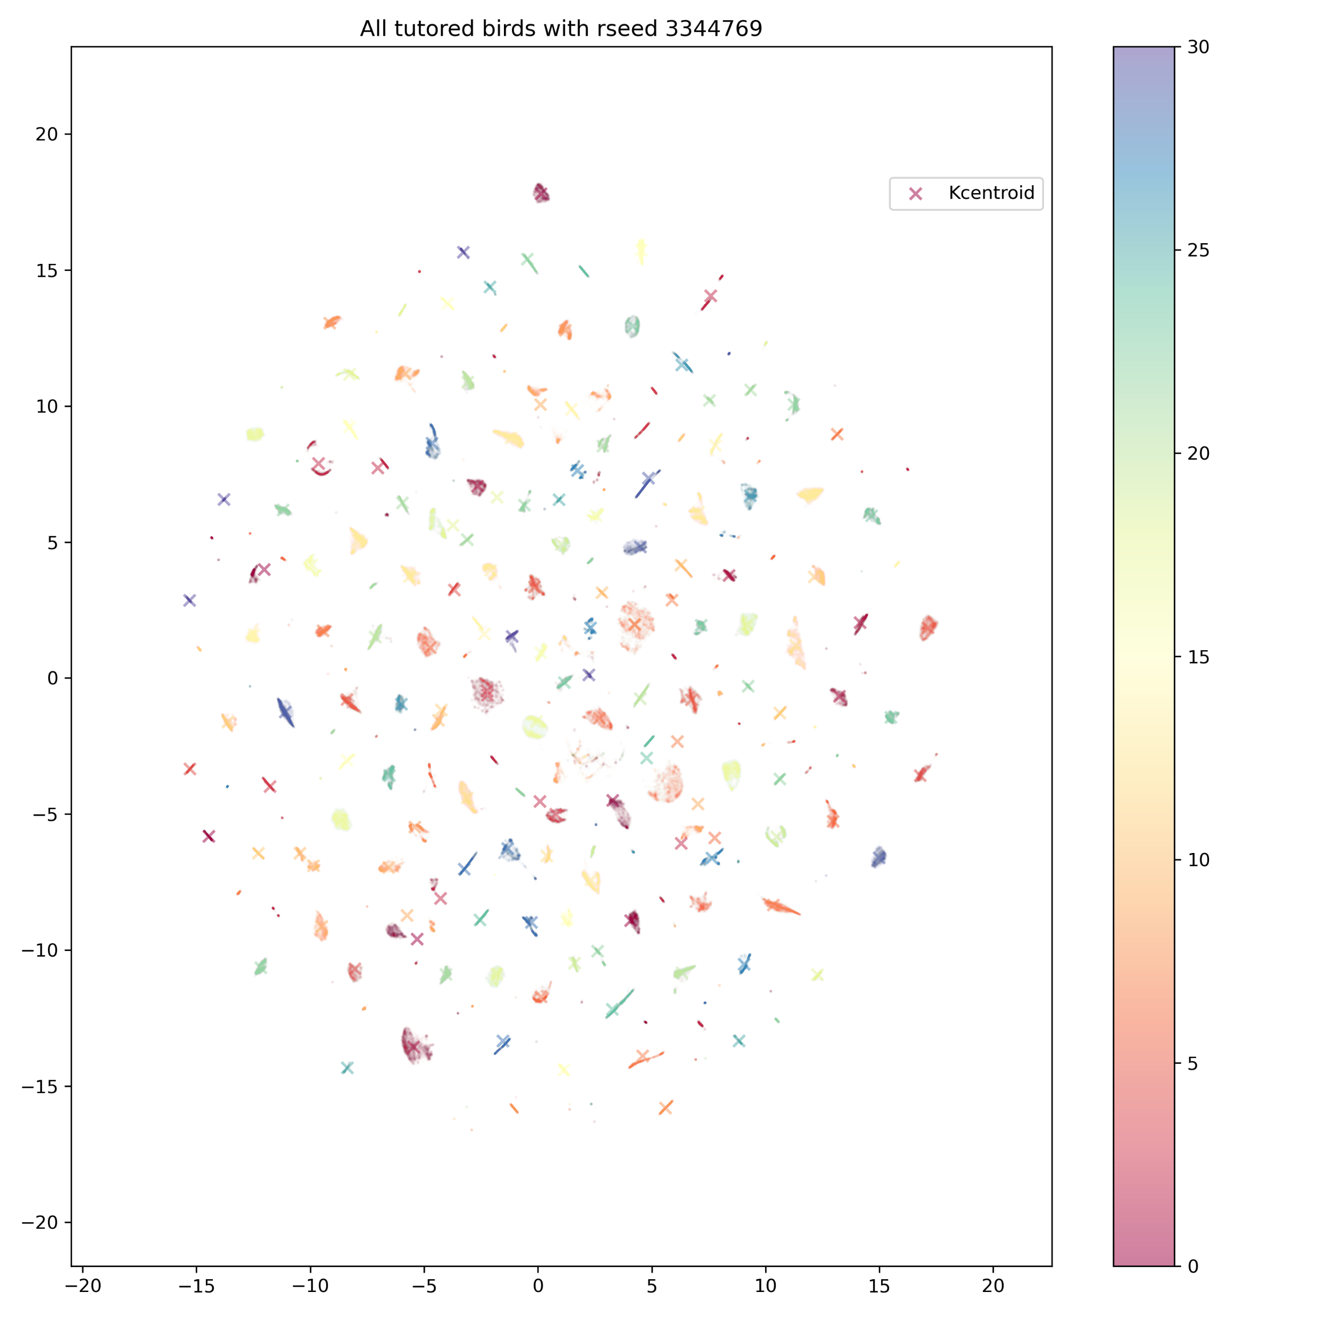
Alam – Test #3: Rseed

Slide 19
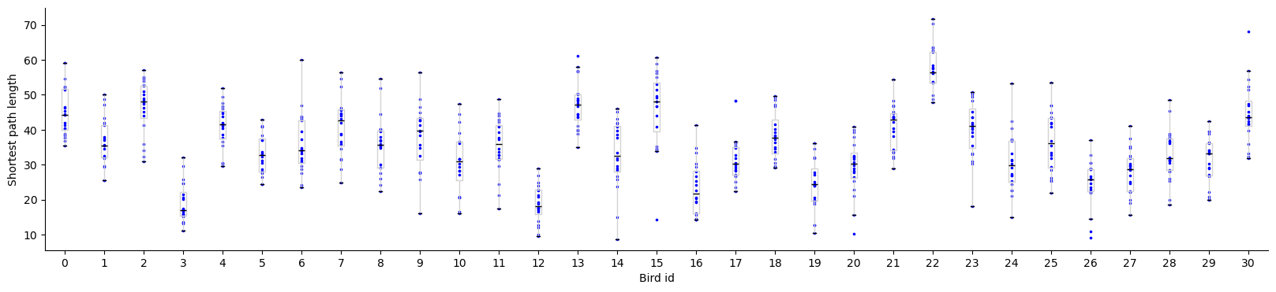
Alam – Test #3a: Rseed

Slide 20
Alam – Test #3a: Rseed

Slide 21
Alam – Test #3b: Rseed

Slide 22
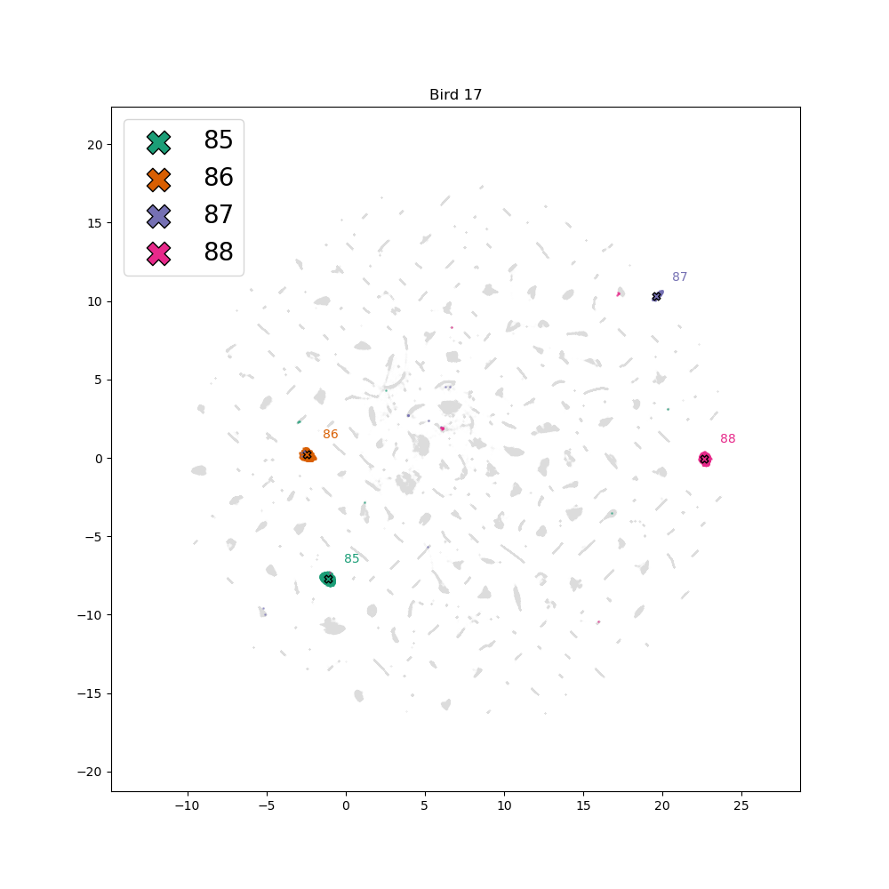
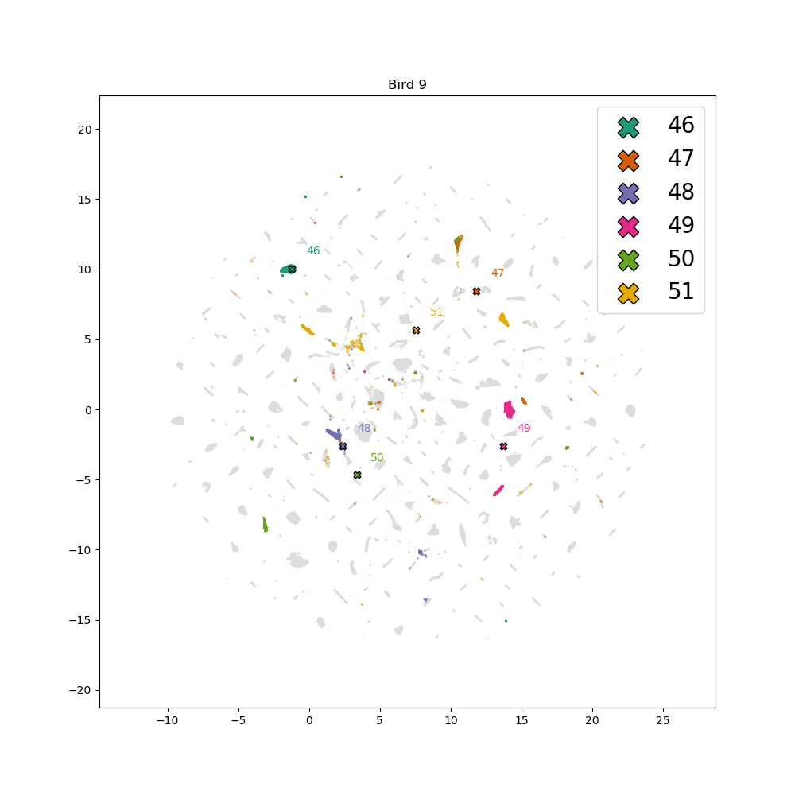
Alam – Issues
Normalisation
Centroid issues in og embedding

